Slide 1
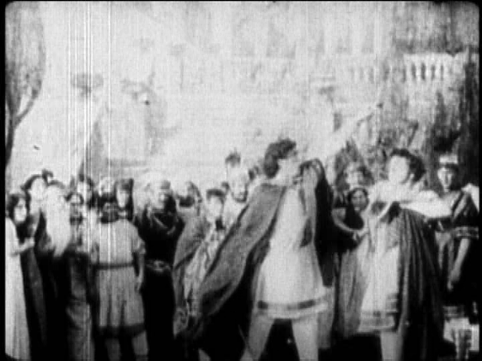
Bill Hart with Ben Hur
(or is that Bill on the right?)

